Slide 1
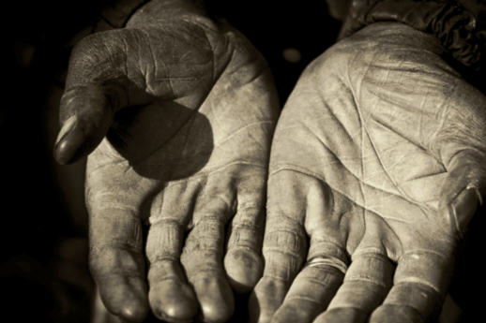
The Application of Salvation
59
Soteriology: God’s Rescue Program
Dr. Rick Griffith • Jordan Evangelical Theological Seminary • BibleStudyDownloads.org

Slide 2
The Application of Salvation
59
The logical order where God grants salvation
Solely of God—calling, regeneration
Involve man as well—conviction, conversion

Slide 3
A Logical Order in the Way of Salvation
59
Conviction
Calling
Regeneration
Faith
Ryrie, Basic Theology, Chapter 56

Slide 4
Your Small Group Presentation
5 minutes: Divide the class into FOUR small groups
20 minutes: Discuss your topic in Ryrie’s chapter 56 (pp. 374-78): either conviction, calling, regeneration, or faith
12 minutes: Present for 3 minutes—use lecture, drama, song, visuals, etc.

Slide 5
A Logical Order in the Way of Salvation
59
Conviction
Calling
Regeneration
Faith
Ryrie, Basic Theology, Chapter 56

Slide 6
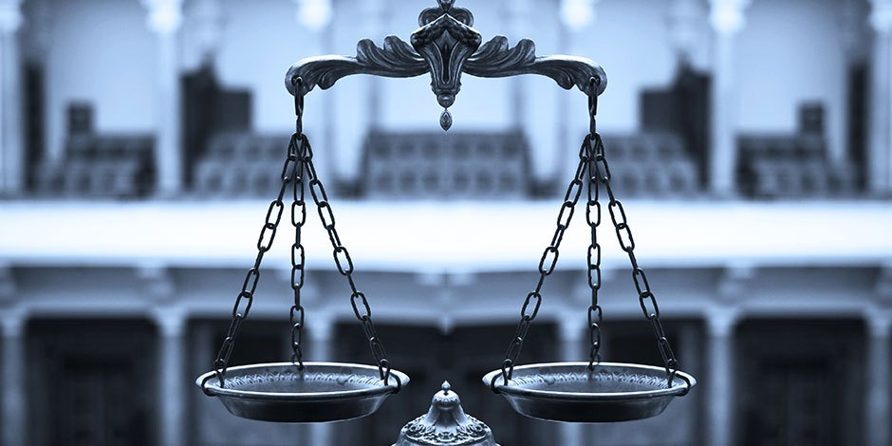
Note the Balance
God
Us

Slide 7
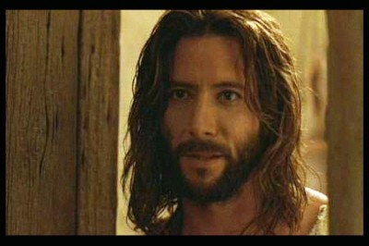
Faith in John
What must you trust about Jesus to be saved?
Must you add anything to this?
What is saving faith?
How is it different from false faith?

Slide 8
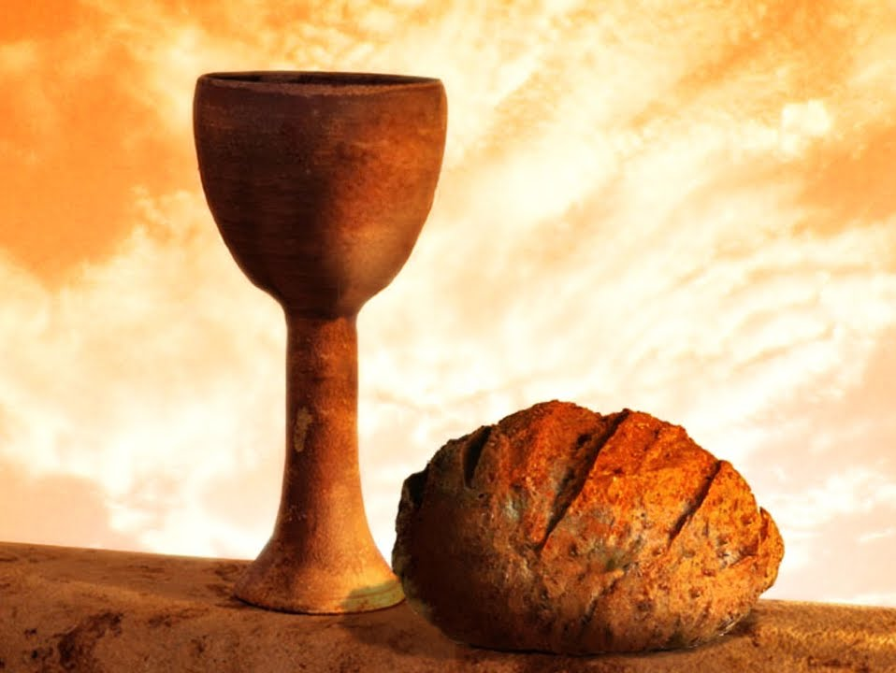
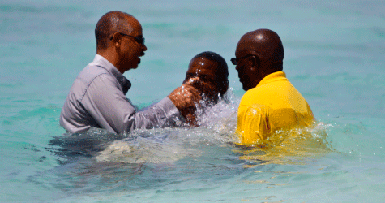
What Role Do the Ordinances Play?

Slide 9
The Main Point: Salvation Results from Activities of Both God and Man
Solely of God—calling, regeneration
Involve man as well—conviction, conversion

Slide 10
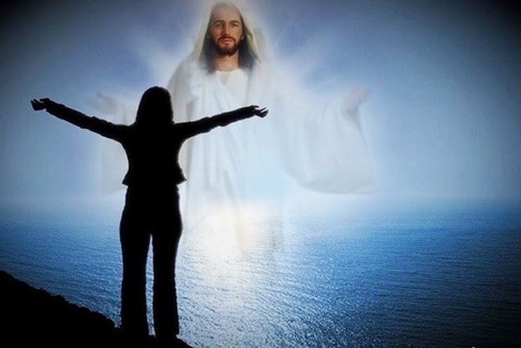
So now what should we do?

Slide 11
Black

Slide 12
Salvation link at BibleStudyDownloads.org
Get this presentation and script for free!

